Slide 1


CE 101 (Engineering Drawing)
Department of Civil Engineering , IIT Guwahati

Slide 2

Syllabus
(2-0-3-7)
Importance of engineering drawing
Conventions and standards: ISO
Orthographic projections: points, lines, planes and solids
Sections of solids
Isometric projections
Development of surfaces
Intersection of solids
Introduction to Computer Aided Drafting software, basic commands of two-dimensional drafting
Application of Intersection of Solids and Isometric Projections in the software

Slide 3
Text/ Reference Books
N. D. Bhatt and V. M. Panchal, Engineering Drawing Plane and Solid Geometry, 53rd Edition Charator Publishing House, 2014
K. Venugopal and V. Prabhu Raja, Engineering Drawing+ AutoCAD, 5th Edition, New Age International, 2011
D. A. Jolhe, Engineering Drawing with an Introduction to AutoCAD, McGraw Hill Education 2017
W. J. Luzadder and J. M. Duff, Fundamentals of Engineering Drawing, 11th Edition, PHI, 2012
F. E. Giesecke, A. Mitchell, H. C. Spencer, I. L. Hill, R. O. Loving, J. T. Dygdon and J. E. Novak, Engineering Drawing, 8th Edition, Person Prentice Hall, 2000

Slide 4
Lecture Classes
Division I: Instructor: Dr Sparsh Johari Classes are in the afternoon (Slot A1) Venue: Lecture Hall – L2 Students (257): ME, CE, Energy | Division III: Instructor: Prof Vinayak Kulkarni Classes are in the forenoon (Slot A) Venue: Lecture Hall – L2 Students (254): CSE, M&C, and EPH
Division II: Instructor: Dr RB. Sharmila Classes are in the afternoon (Slot A1) Venue: Lecture Hall – L4 Students (253): BSBE, ECE, EEE | Division IV: Instructor: Dr Sayantan Chakraborty Classes are in the forenoon (Slot A) Venue: Lecture Hall – L4 Students (249): CL, CST, DS&AI, DD

Slide 5
Tutor Schedule
Day/Time | 0900 – 1155 Hrs. | 1400 – 1645 Hrs
Monday | ML1A: Prof Ganesh Narayanan (ME) ML1B: Nayan Jyoti Sarma (ST1) ML1 Group (Students group: L3) | AL1A: Dr Vinodh Bandaru (ME) AL1B: Alok Bijalwan (ST2) AL1 Group (Students group: L8)
Tuesday | ML2A: Dr. Rinku Mittal (ME) ML2B: Naveen Kumar (ST3) ML2 Group (Students group: L1) | AL2A: Prof Mohammad Jawed (Civil) AL2B: Dr Bhaskar Kumar (ME) AL2 Group (Students group: L6)
Wednesday | ML3A: Dr Ujendra Kumar Komal (ME) ML3B: Abdur Rahaman (ST4) ML3 Group (Students group: L4) | AL3A: Prof Teiborlang L. Ryntathiang (Civil) AL3B: Charakho N Chah (ST5) AL3 Group (Students group: L9)
Thursday | ML4A: Dr Ravi K. (Civil) ML4B: Mrinal Roy (ST6) ML4 Group (Students group: L2) | AL4A: Dr Nipjyoti Bharadwaj (Civil) AL4B: Sumantra Chaudhuri (ST7) AL4 Group (Students group: L7)
Friday | ML5A: Dr Sreeja P. (Civil) ML5B: Sahil Kumar (ST8) ML5 Group (Students group: L5) | AL5A: Dr Pranav (IPDF) AL5B: Tholeti Venkata Satya Aditya (ST9) AL5 Group (Students group: L10)
ML: Morning Lab, AL: Afternoon Lab, ST: Student Tutor, A = 1203 room, B = 1204 room

Slide 6




Know your Instructors
Prof. Vinayak Kulkarni
Dr. Sayantan Chakraborty
Dr. RB.Sharmila
Dr. Sparsh Johari
Coordinator CE101

Slide 7
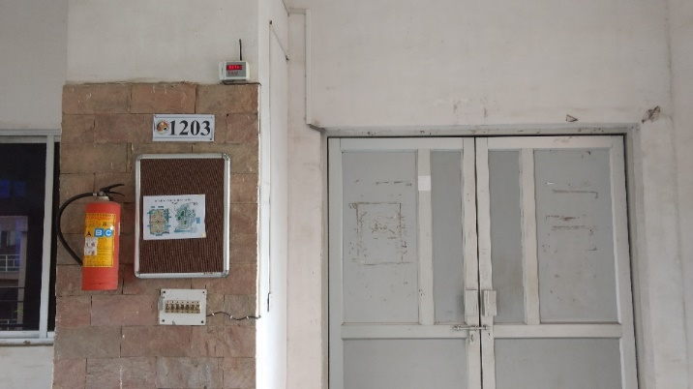
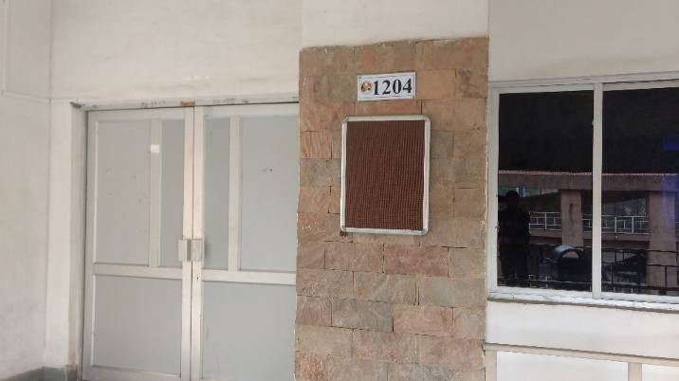
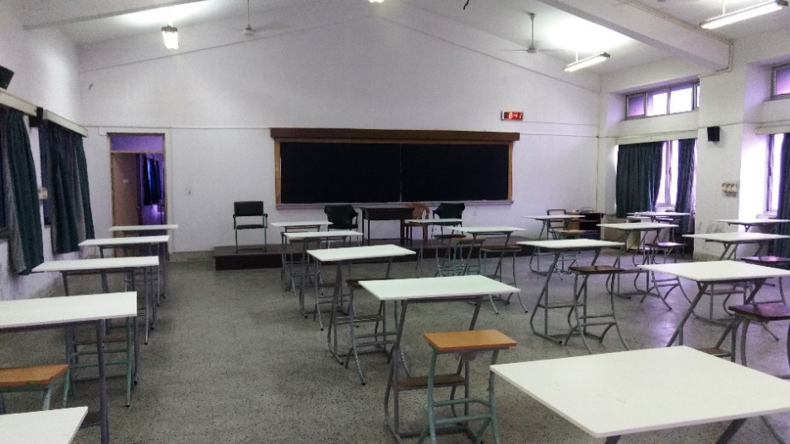
Know your Lab classrooms

Slide 8
Tutorials
Tutorial questions
The tutorial sheets will be uploaded by the coordinator on MS Teams (under assignments), which will be reflected to the students on MS Teams at the time of their tutorial sessions.
Conversations/ instructions/ updates related to the course will be done through ce_101@iitg.ac.in E-mail id
The tutorial sessions have been scheduled as per the academic timetable provided by Academic Section, IIT Guwahati
Number of tutorials
A total of 11 tutorials are included in the course
Nine tutorials will be on drawing sheets in the 1203 and 1204 drawing halls
One makeup tutorial will be on drawing sheets in the 1203 and 1204 drawing halls
Two tutorials will be conducted on AutoCAD in computation labs 305 and 306, on the 3rd Level, New Extension Building, HSS Department

Slide 9
Instruction & Tutorial Schedule

Slide 10
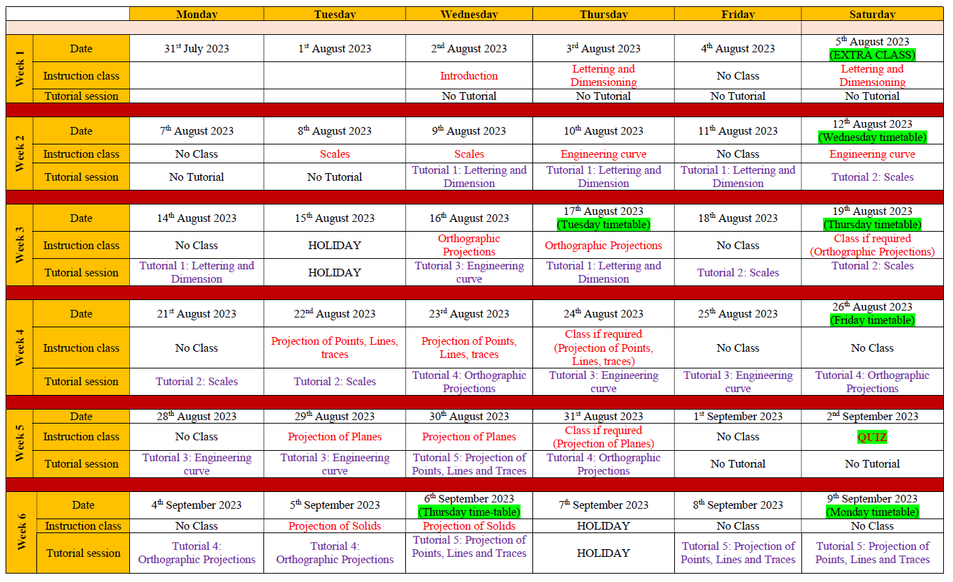

Slide 11
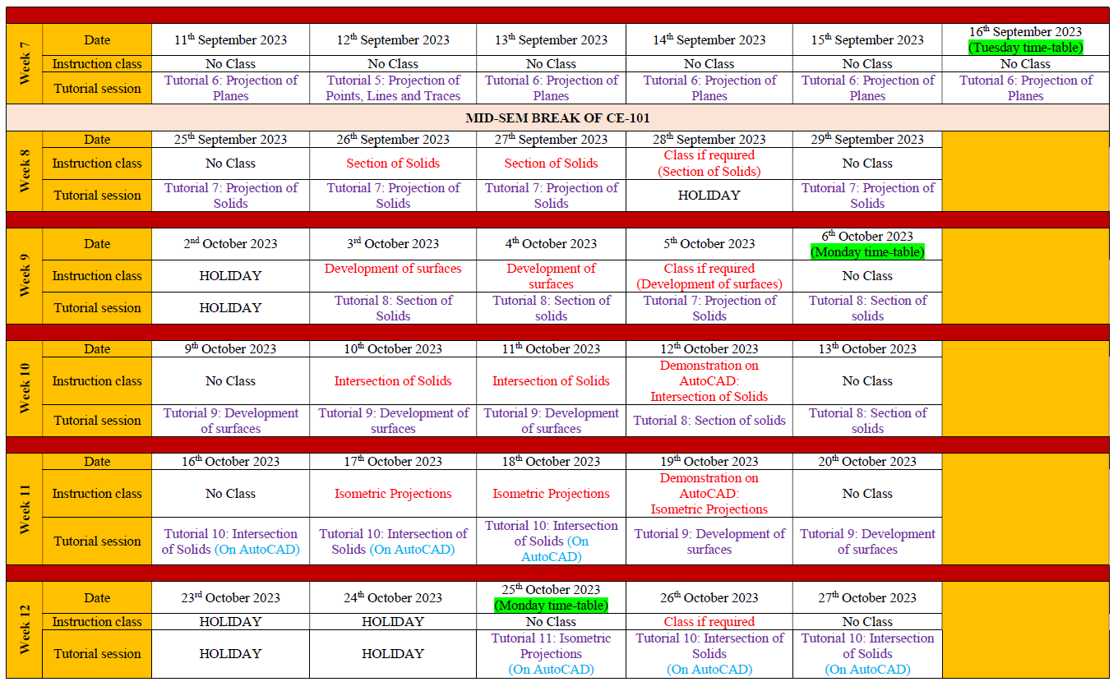

Slide 12
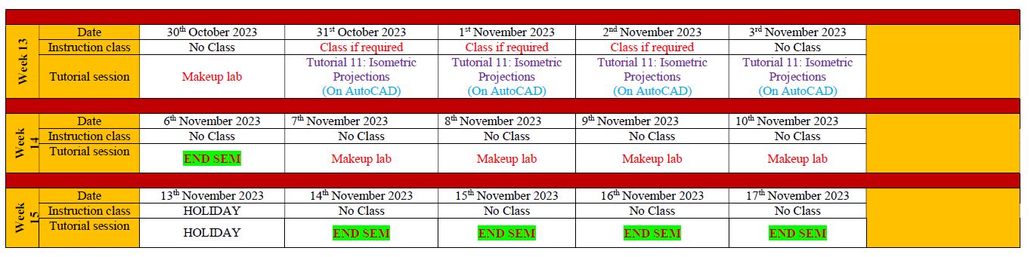

Slide 13
Tutorials (Cont…)
Class notes/ PPTs in hardcopy/ digital copy (in mobile phone) the instructors provided are allowed in the tutorial sessions. One-on-one discussion is also allowed
When the students start their work on their drawing sheets, the Tutor/ TAs will put their signature on each of the drawing sheets mentioning the date of the tutorial lab
After 1st Tutorial, students can bring their sheets with an already-prepared title box
Students should enter the lab with the drawing kit and A2 sheets (if not, call to be taken by the tutor)
After completing the tutorial session (175 minutes)/ completion of the tutorial sheet by the students, the sheets will be collected by the Tutor. The unevaluated sheet cannot be taken by the student out of the drawing hall

Slide 14
Tutorials (Cont…)
Attendance
Lecture class and tutorial session attendance are mandatory (as per the ordinance)
Evaluation of Tutorial sheets
The marks of the evaluated sheets will be uploaded on MS Teams under Assignments
The evaluated tutorial drawing sheets will be returned to the students in the next tutorial session, where students can discuss/ clear doubts about the evaluated sheet with Tutor/ TAs. Students must check their marks on MS Teams on/ before the day the evaluation sheets are handover to them

Slide 15
Make-up Tutorial
The student is allowed for makeup tutorial IF AND ONLY IF regular tutorial session (on drawing sheet) is missed for GENUINE MEDICAL REASON
Student can make up only ONE tutorial in the Makeup tutorial, even if he/she has missed more than one
The schedule of the makeup tutorials is provided in the grand schedule of the course
Students are not allowed to sit in a makeup tutorial for the completion of the incomplete assignments
The makeup tutorial is only for those tutorials which are scheduled to perform on drawing sheets
There is no makeup tutorial for AutoCAD sessions

Slide 16
Evaluation
Quiz
The quiz will be conducted by the instructors on 2nd September 2023 (the date may change based on the availability of the computer lab)
The quiz will be an objective type
The topics till ‘Projection of Planes’ will be considered as the syllabus of the quiz
The evaluated marks of the quiz will be uploaded on the MS Teams
End-SEM examination
End-SEM examination will be conducted on drawing sheets in the 1203 and 1204 rooms
The schedule of the End-SEM is provided in the grand schedule of the course

Slide 17
Marking scheme
Distribution of marks
Tutorial (On drawing sheets)= 45% (Nine tutorials, one Makeup tutorial)
Tutorial (On AutoCAD) = 5% (One out of two drawings)
Attendance (Instruction class) = 10%
Quiz = 15%
End-SEM = 25%

Slide 18
What is Engineering Drawing?
Drawing is a graphic representation of:
a real thing
an idea
a proposed design for later manufacture or construction
Graphic representation:
Artistic: to express aesthetic, philosophic or other abstract ideas
Technical: to represent the design of objects to be built or constructed

Slide 19

Why Drawing for Engineers?
To detail the maximum possible information than the normal vision
In the process of product development, two steps are involved:
Product specification
Product drawing
Irrespective of engineering discipline, any engineer should have a bare minimal understanding of engineering drawing
T
A simple example:
What do you see from different angles?
These are categorized as different views in engineering drawing. These are vital information when you consider “a product to be developed” in place of a dice
BS
RS
LS
T: Top view or plan; B: Bottom view
FS: Front side view or elevation
BS: Back side view
LS: Left side view; RS: Right side view
FS
B
All the views have to be successfully perceived and sketched before it can be developed, be it a nano, micro or macro product

Slide 20
Objectives
To make and read correct graphics representations of engineering objects, structures and designs
To be able to execute the work with neatness, speed, and accuracy
To visualize the objects in three-dimension space

Slide 21


Slide 22
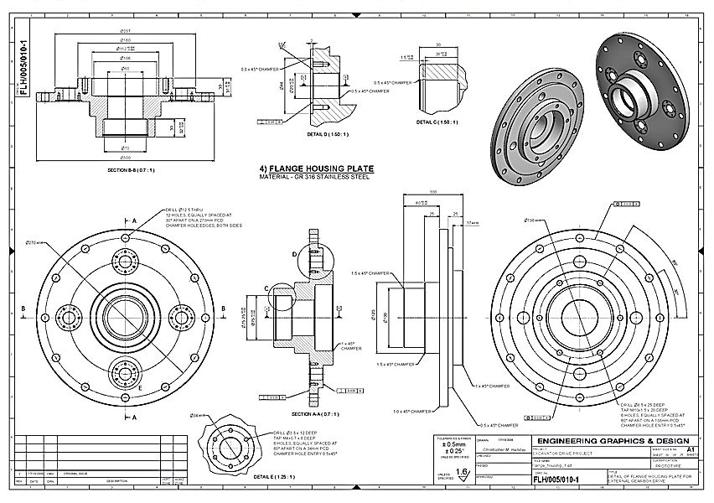
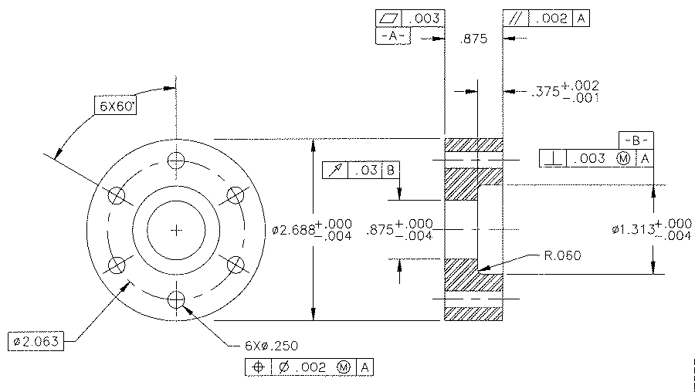

Slide 23
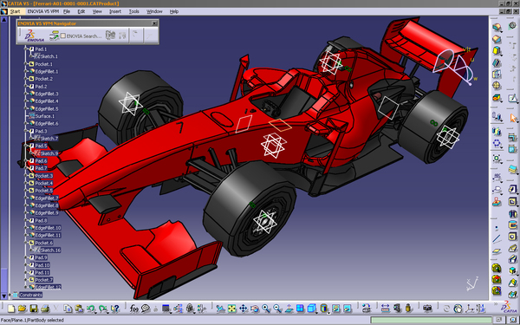
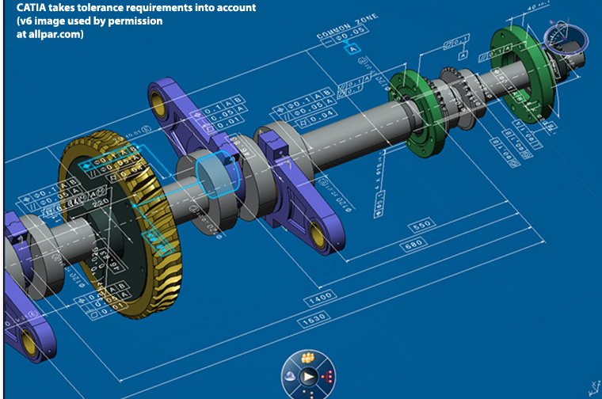

Slide 24
Lab Pre-requisites
Mini Drafter
Drawing sheet
Instrument box
compasses
dividers
Set-squares
eraser
French curves
Drawing clips, pins or adhesive tape
Pencils: Grades: H, 2H, HB and B
Pencil sharpener

Slide 25
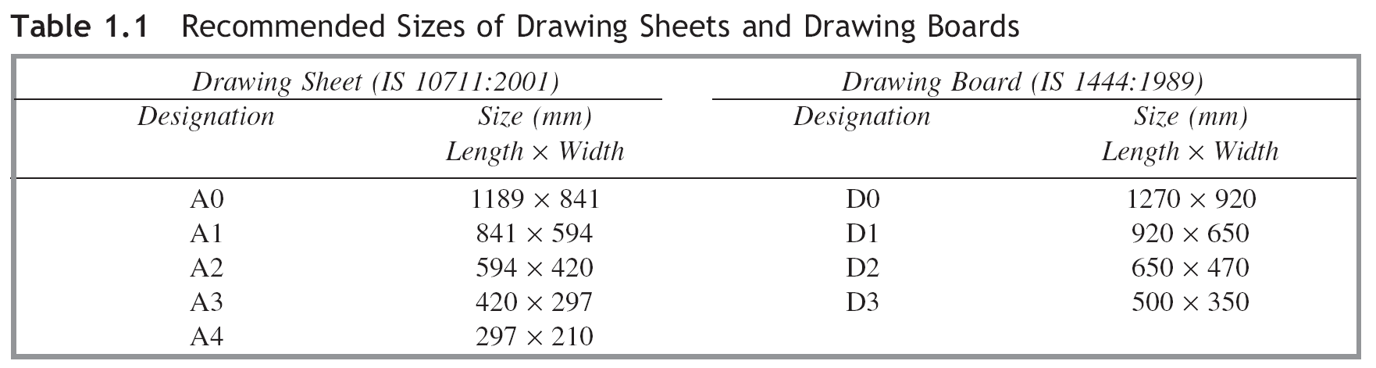
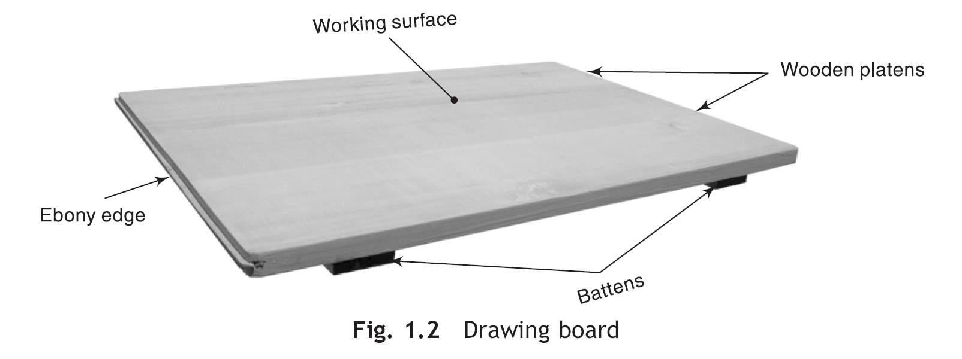
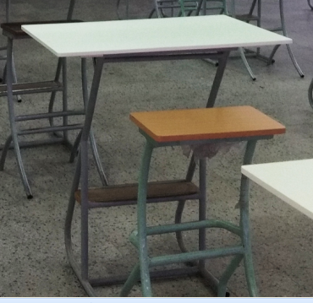
Prerequisite For Engineering Drawing

Slide 26
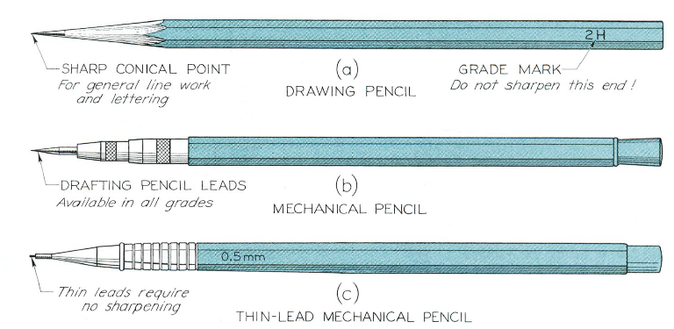
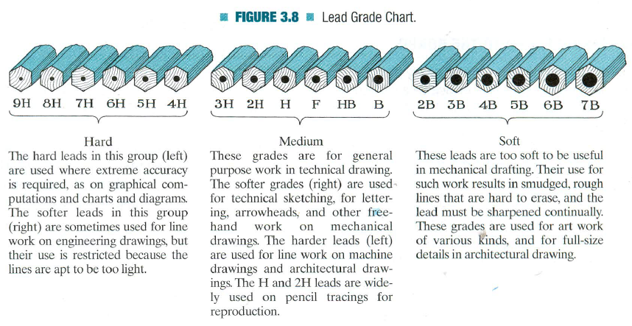
Prerequisite For Engineering Drawing
Lead Grade Sheet

Slide 27
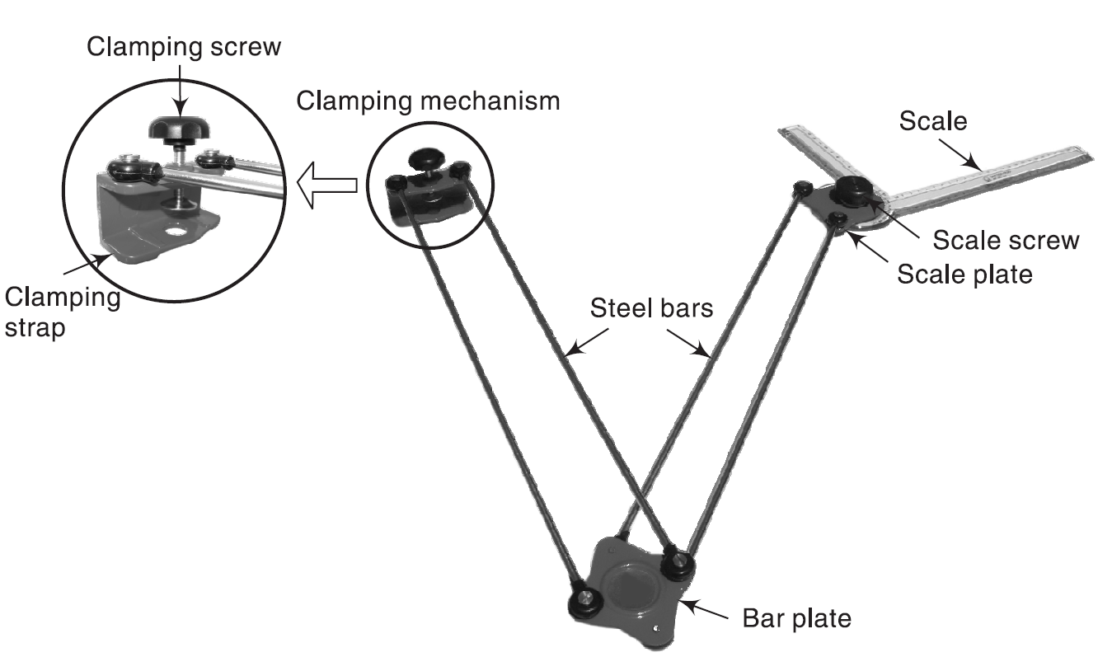
Prerequisite For Engineering Drawing

Slide 28
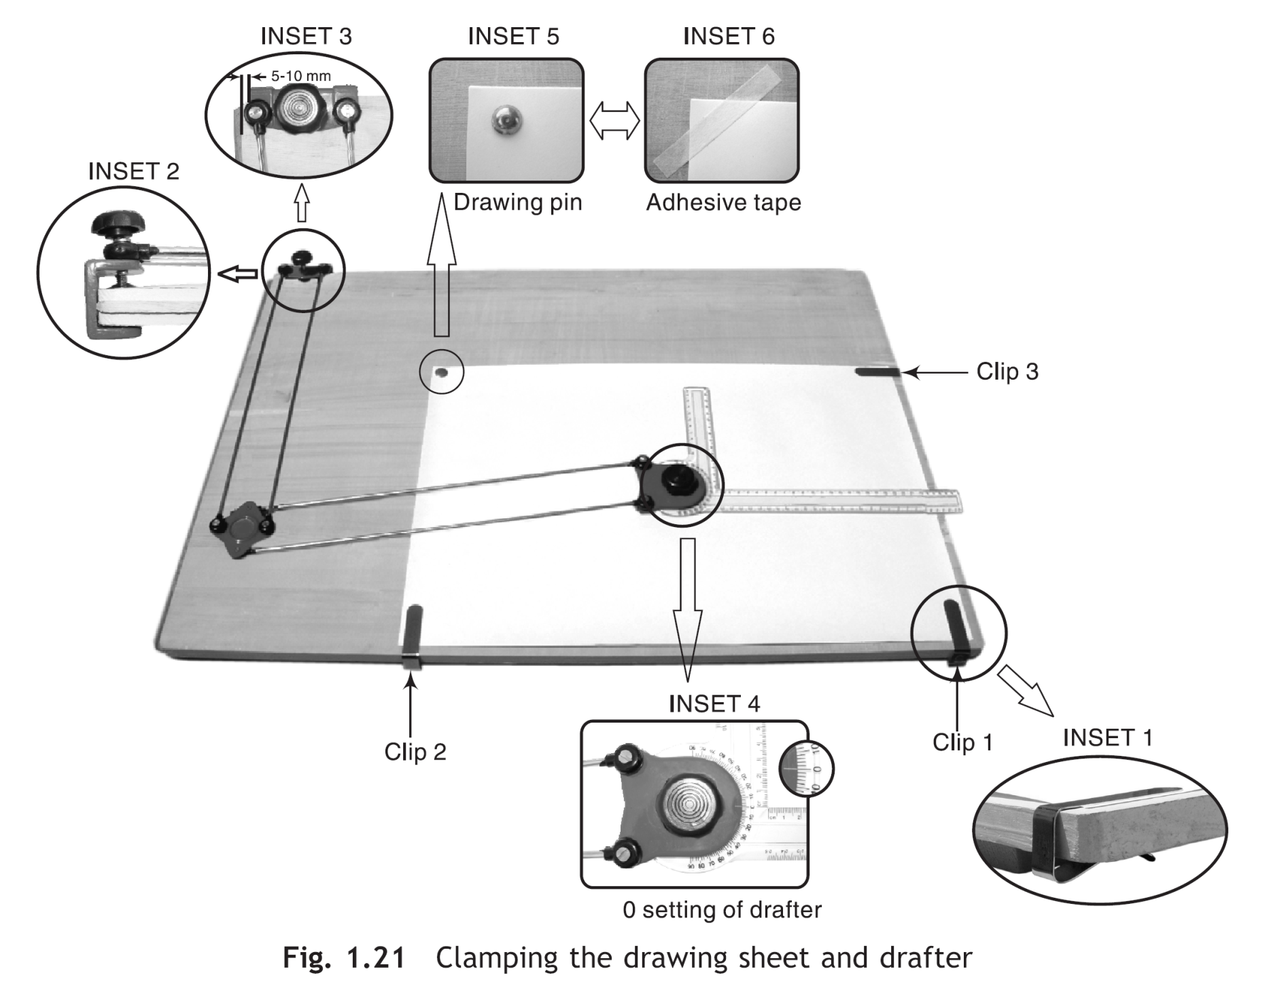
Prerequisite For Engineering Drawing

Slide 29
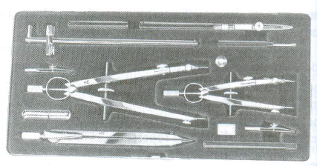
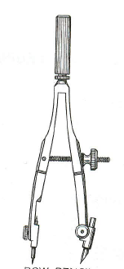
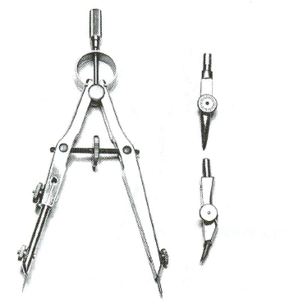
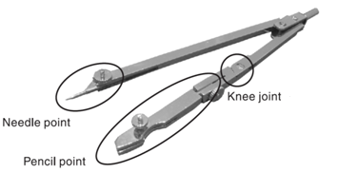
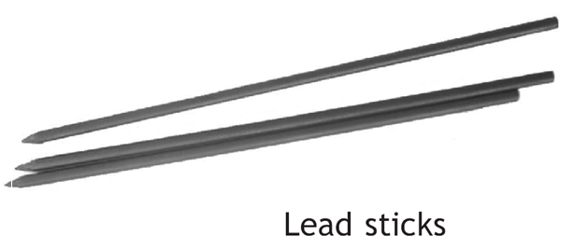
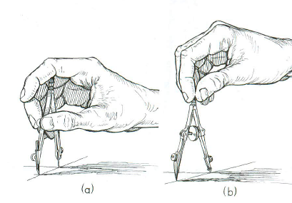
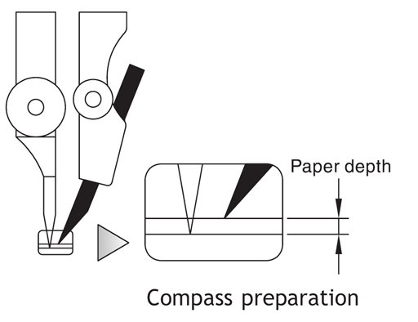
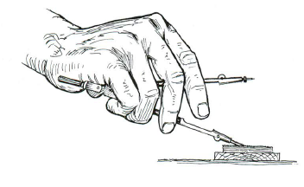

Slide 30
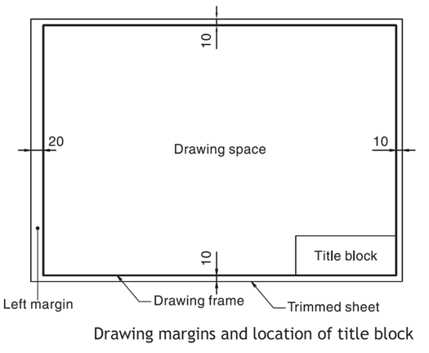
Prerequisite For Engineering Drawing

Slide 31
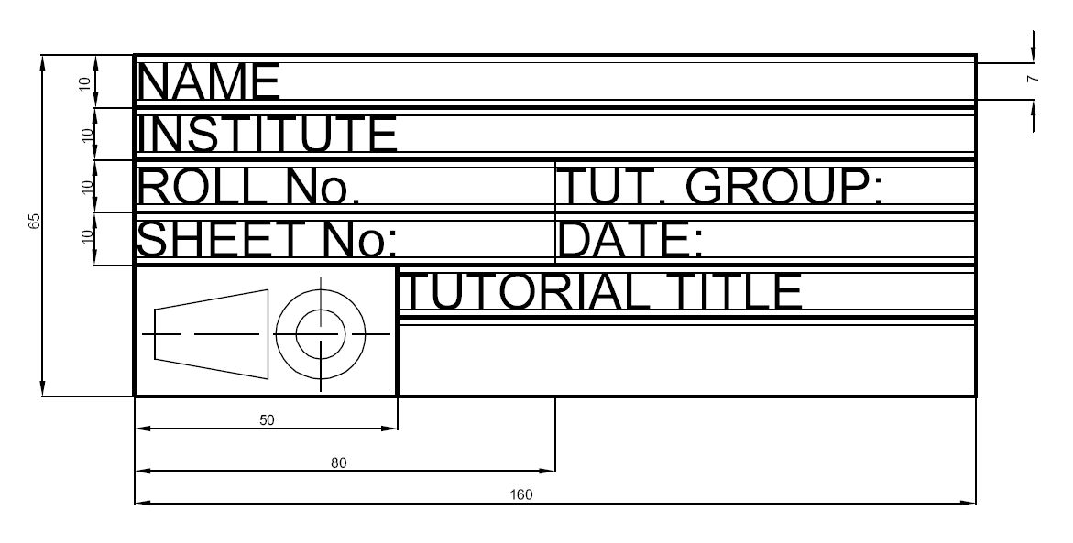
Prerequisite For Engineering Drawing

Slide 32
Graphic Language in
Engineering Drawing
“Engineering drawing” or “blueprint” uses lines to
represent the features of an object.
Features of an object are surface (include plane) and
edge.
Surface
Edge

Slide 35
Basic Strokes
Straight
Slanted
Horizontal
Curved
Examples
“I” letter
“A” letter
“B” letter
4
5
1
1
2
1
3
6
3
2

Slide 36
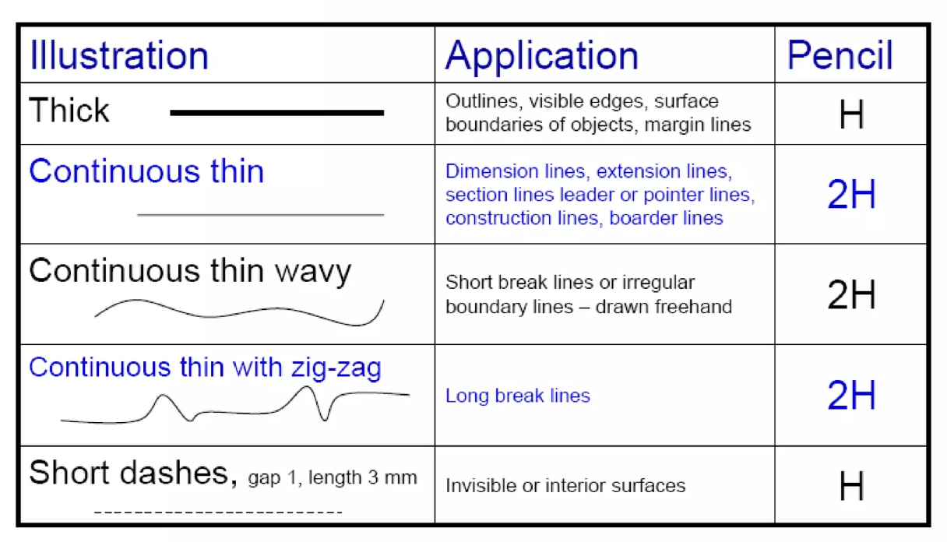
Line types

Slide 37
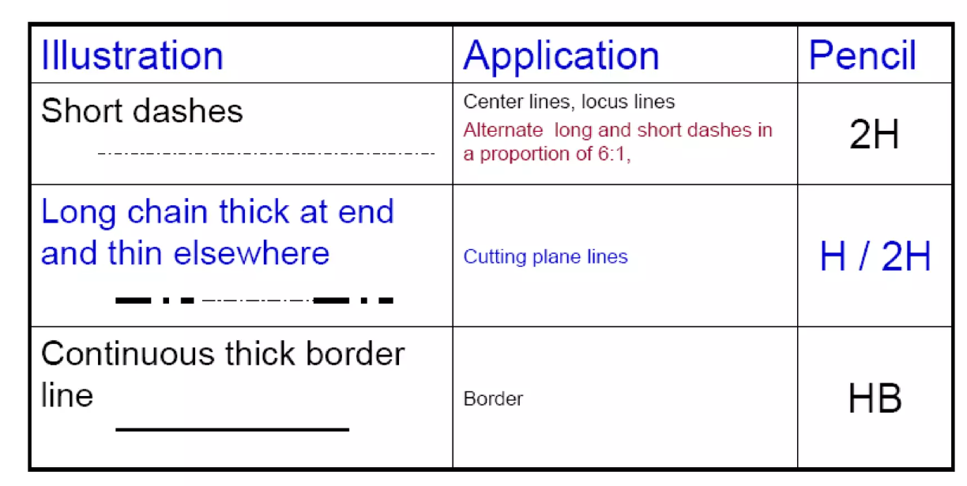

Slide 39
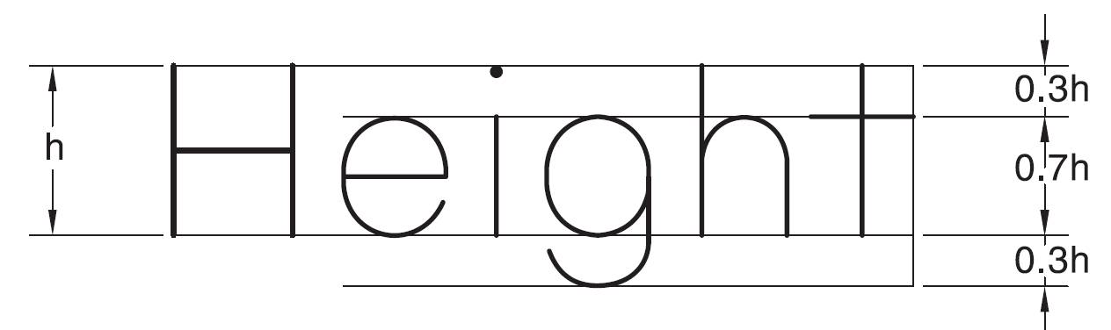
LETTERING
Single stroke: Thickness in single stroke lettering is obtained by a single stroke of pencil
The pencil or pen can be lifted while completing a particular letter
Height and Width of Letters
BIS (SP 46: 2003) has recommended the heights of letters as: 1.8 mm, 2.5 mm, 3.5 mm, 5 mm, 7 mm, 10 mm, 14 mm and 20 mm.
Large-sized letters are used for main titles and headings, medium-sized letters for subtitles and important notes and small-sized letters for dimensions and general notes.
The height of letters bears direct relationship with the size of drawing, i.e., large-sized letters for larger drawings and small-sized letters for smaller drawings.
The height-to-width ratio varies from letter to letter. Most of the letters follow the ratio 7 : 5 or 7 : 6.

Slide 42
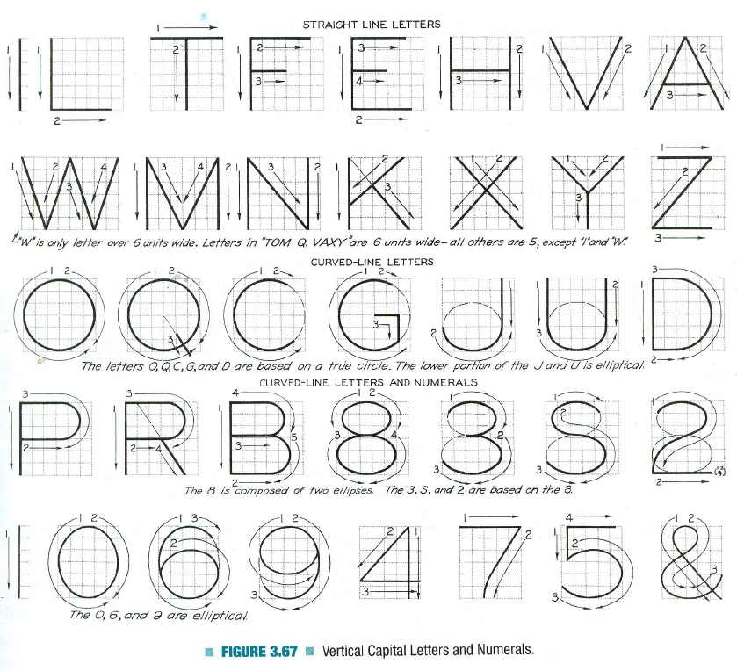
Vertical Capital Letters and Numeric

Slide 43
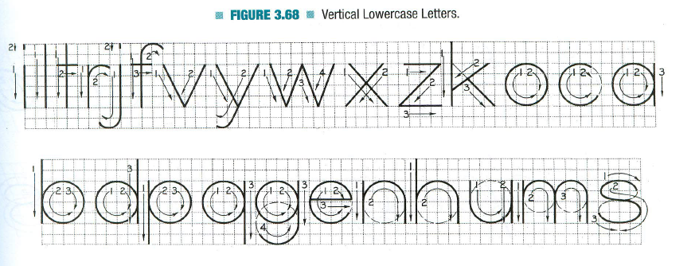
Vertical Lowercase Letters

Slide 44
Lettering Rules
Draw letters as simple as possible. Artistic or cursive lettering should be strictly avoided.
Draw letters symmetrical about the vertical axis or horizontal axis. Asymmetric letters like, F, R, Z, 4, etc., may be drawn as they are.
Round-off the sharp corners wherever necessary, e.g., D, P, S, etc.
Draw all letters legible and uniform.
The height of all the letters in one line should be the same.
Use single stroke vertical CAPITAL letters as much as possible.

Slide 46
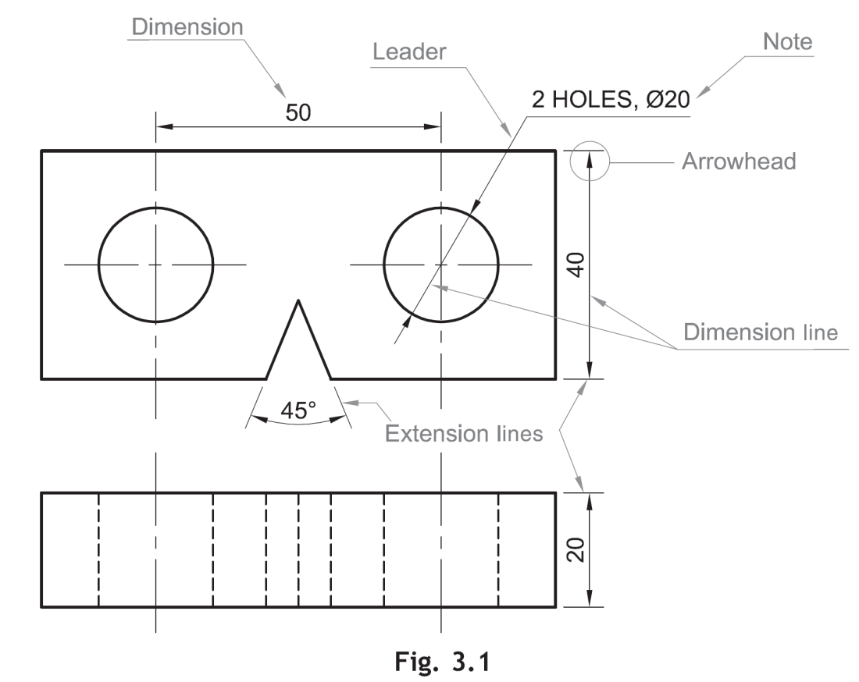
Dimensioning
Dimension is a numerical value expressed in appropriate units of measurement and indicated graphically on technical drawings with lines, symbols and notes (BIS SP 46: 2003)
Dimensioning is done by a set of extension lines, dimension lines, leader lines, arrow heads and dimensions
Symbol for diameter
Unit of length mostly in millimeter
Angles in degrees
Symbols to indicate specific geometry

Slide 47
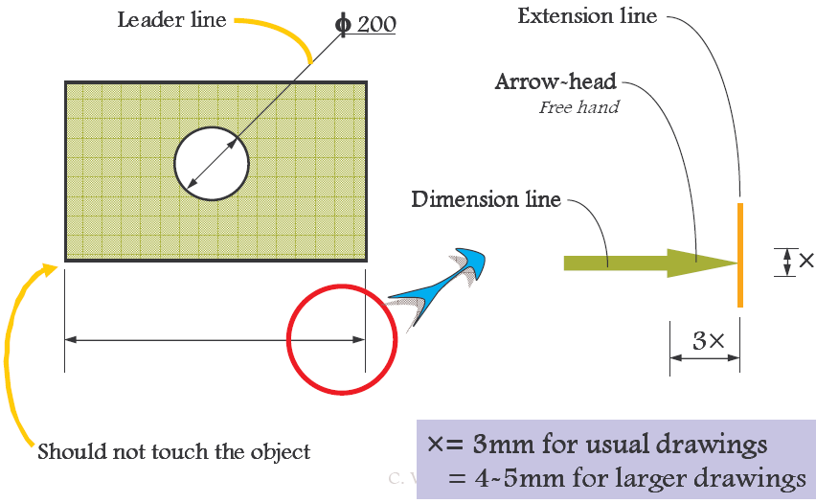
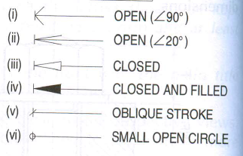
Dimension line: Dimension line is a thin continuous line. It is terminated by arrowheads touching the outlines, extension lines or centre lines
Extension lines: An extension line is also a thin continuous line drawn in extension of on outline. It extends by about 3 mm beyond the dimension line
Arrowheads: An arrowhead is placed at each end of a dimension line. Its pointed end touches an outline, an extension line or a center line. The size of an arrowhead should be proportional to the thickness of the outlines. The length of the arrowhead should be about three times its maximum width
Leader: A leader or a pointer is a thin continuous line connecting a note or a dimension figure with the feature to which it applies.

Slide 48
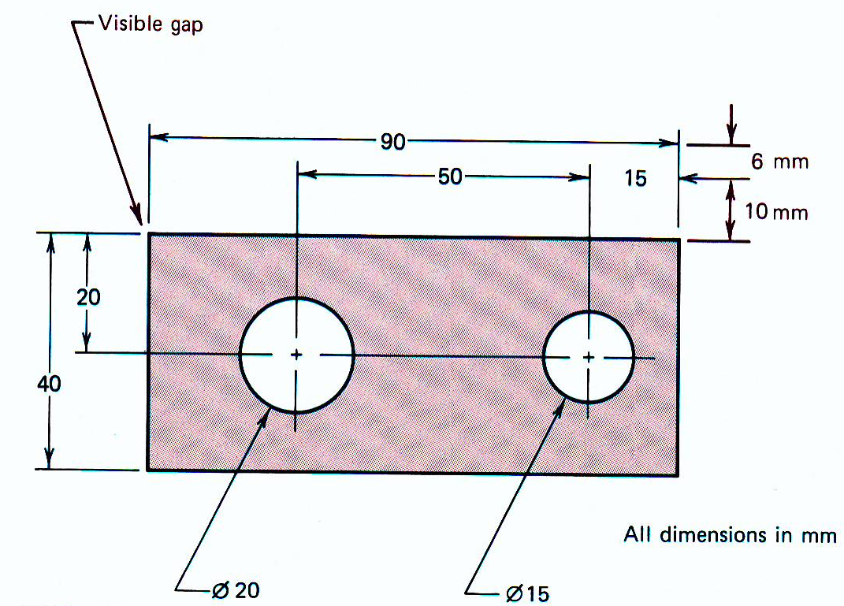
Dimension lines should be drawn at least 10 mm away from the outlines
Smaller dimensions should be placed near the view and the larger away so that extension lines do not cross dimension lines
As far as possible, all the dimensions should be placed outside the views.
Inside dimensions are preferred only if they are clear and easily readable (Avoided)

Slide 50
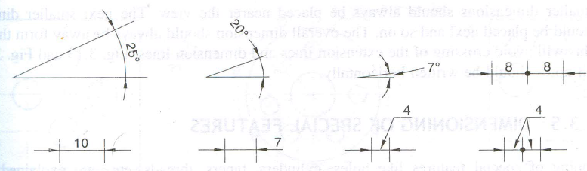
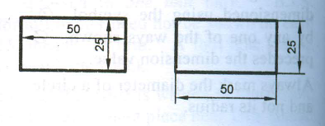
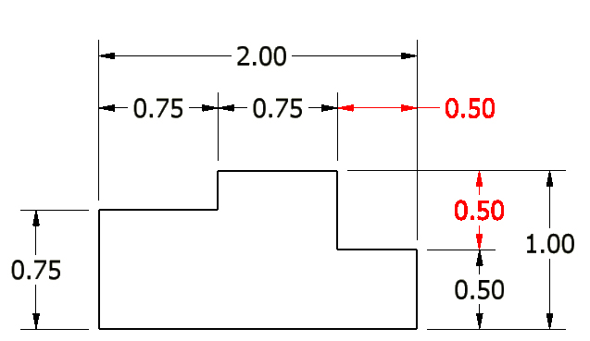
Arrowheads should be drawn within the limits of the dimensioned feature.
When the space is too narrow, they may be placed outside
Dimensions should be placed outside the views
Each dimension should be given only once. No dimension should be redundant
.

Slide 51
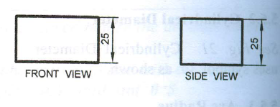
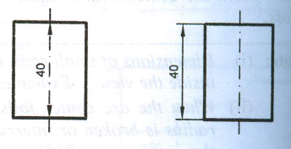
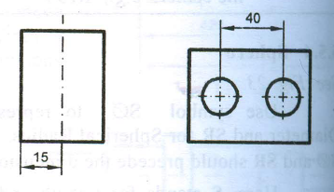
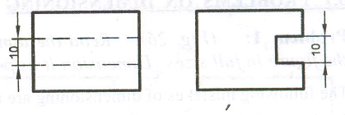
Do not repeat the same dimension in different views
Center line (axis) itself should not be used as a dimension line with arrowheads at its ends
Center line(axis) itself shall not be used as a dimension line with arrowheads as its ends
Dimensions shall be given to visible lines and not to hidden lines

Slide 52
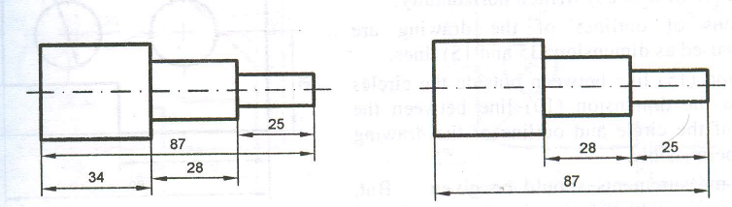
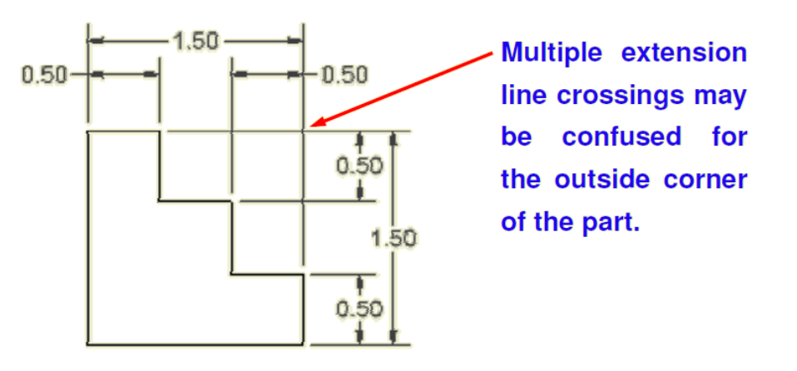
Overall dimension shall be placed outside the intermediate dimensions, i.e. smaller dimensions shall be placed nearer the view and the larger farther away so that extension lines do not cross dimension lines

Slide 54
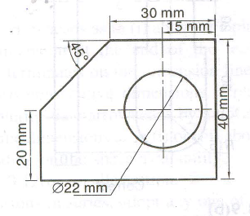
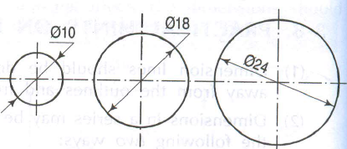
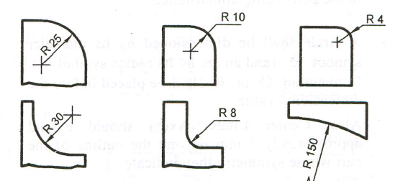
The unit should not be written after each dimension, but a note mentioning the unit should be placed below the drawing.
Circle should be dimensioned by its diameter. The dimensioning should be preceded by the symbol φ
Figure shows various methods of dimensioning different sizes of circles
Arc Radius: An arc is dimensioned by its radius R by any one of the ways. Only one arrowhead with its point on the arc end of the dimension line is used
Dimension line of a radius should pass thorough the center of the arc. Mark the center with a small cross

Slide 55
Spherical radius

Slide 56
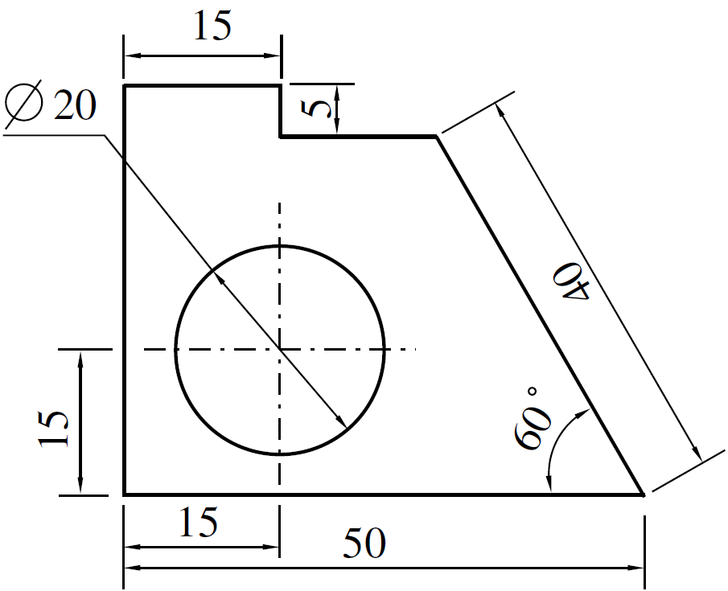
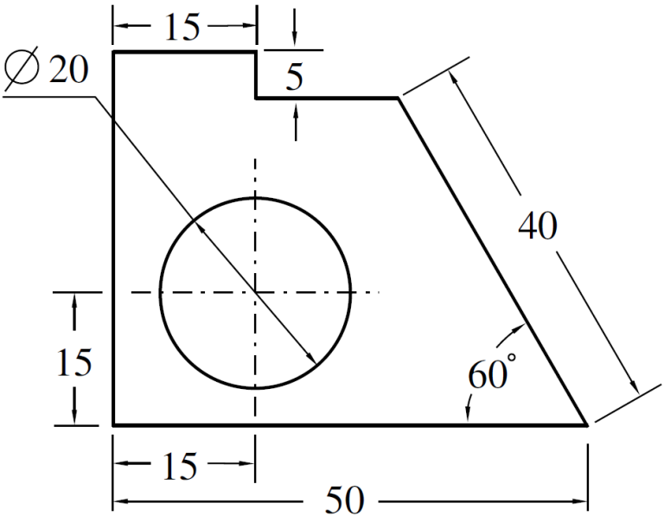
All the dimensions on a drawing must be shown using either Aligned System or Unidirectional System. In no case should, the two systems be mixed on the same drawing.
Aligned System: Dimensions are placed perpendicular to the dimension line so that they may be read from the bottom or right-hand side of the drawing sheet. Dimensions are placed at the middle and above of the dimension lines.
Unidirectional System: Dimensions are placed in such a way that they can be read from the bottom edge of the drawing sheet. Dimension lines are broken near the middle for inserting the dimensions. (PREFERRED)

Slide 58


Slide 62

Metric Units

Slide 63
Self Study
Please refer to any engineering drawing text book
Dividing line into equal parts
Dividing circle into equal parts
Perpendicular bisection
Angular bisection
Construction of triangles
Construction of regular polygons such as pentagon, hexagon
Inscribed circles
Drawing tangents and normal

